Slide 1

BACHELOR OF SCIENCE IN STATISTICS
DEPARTMENT OF STATISTICS,
RAJAH SERFOJI GOVT COLLEGE,
THANJAVUR-613001.

Slide 2

Data Analytics with Tableau
SUBSCRIBER'S GALORE: EXPLORING THE WORLD'S TOP YOUTUBE CHANNELS

Slide 3
Meet MY Team
Sri Balaji . P 21ST4923
Govinda Vasakan . M 21ST4906
Thayanithimaran . S 21ST4923
Balathandayuthabani . R 21ST4905
Santhiya . S 21ST4940
GUIDE BY
Dr. A. Joshua Joseph

Slide 4
INTRODUCTION OVERVIEW
The project is a web-based platform focused on the world's top YouTube channels, providing users with data analytics on channel performance and user engagement. The purpose of the platform is to help channel owners and marketers understand what makes these channels successful and apply those insights to their own marketing strategies. Users can search for channels by name or by keyword, and view detailed analytics on channel metrics such as subscribers, views, engagement rate, and subscriber growth. The platform also offers insights on user demographics, top videos, and engagement metrics such as comments, shares, and likes. The platform will be designed to provide users with a comprehensive analysis of the channels, including trends over time and comparative metrics.

Slide 5
PURPOSE
*1. Data Analytics for Marketers* Marketing professionals and businesses can use the platform's data analytics to understand the success of top YouTube channels and apply those insights to their own marketing strategies. They can learn about the top channels in various industries, the types of content that are most popular, and the trends that drive engagement and growth.
*2. Channel Analysis and Optimisation* Channel owners and YouTubers can use the platform's analytics to track their own channel performance, identify areas for improvement, and make data-driven decisions to enhance their strategy. They can learn about their channel metrics, including the top videos and most engaged users, and make changes to improve their engagement, subscriber growth, and overall success.
*3. Industry Overviews* The platform can provide a comprehensive overview of the YouTube ecosystem, offering insights into the top channels in various industries, trends in content creation, and audience engagement. This information can be useful for both marketers and channel owners seeking to stay ahead of the curve and stay informed about the latest developments in the space. *4. Competitive Intelligence* Competitors in the same industry can use the platform to understand the
performance of rival channels, identify trends and best practices, and make informed decisions about their own strategy. They can learn more about their competitors' strengths and weaknesses, understand their audience demographics, and identify areas for improvement.
*5. Research for Academic Work* Researchers and students studying the YouTube ecosystem and related topics, such as social media marketing and audience engagement, can use the platform as a data source for their work. The platform can provide a large and comprehensive database of channel metrics, insights, and trends, which can be used for research studies, academic papers, and other academic work.

Slide 6
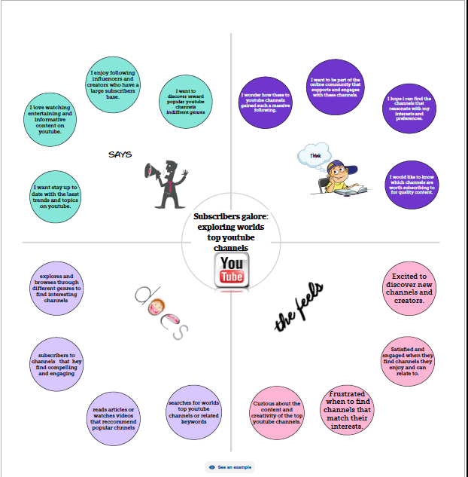
EMPATHY MAP

Slide 7
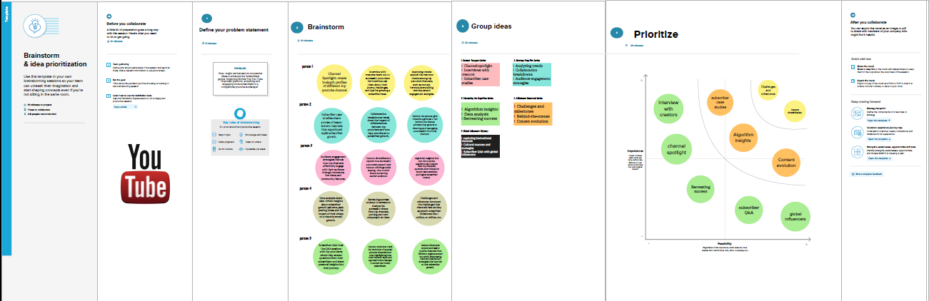
BRAINSTORMING MAP

Slide 8
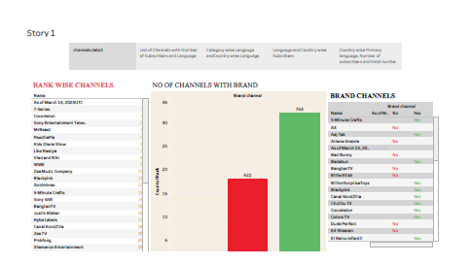
RESULTS

Slide 9
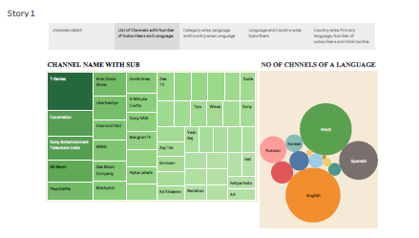

Slide 10
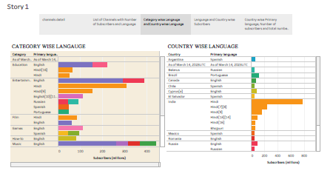

Slide 11
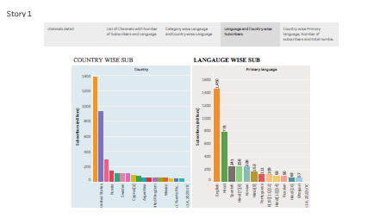

Slide 12
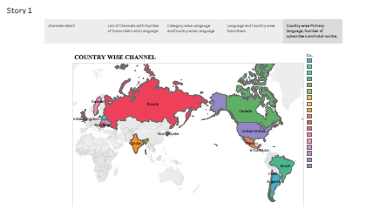

Slide 13
ADVANTAGES
1. Competitive Edge - Marketers and businesses can gain a competitive edge in promoting their brand by using the platform's data analytics to understand the success of top YouTube channels and applying those insights to their own marketing strategies.
2. Channel Growth - Channel owners and YouTubers can use the platform's analytics to track their own channel's performance, identify areas for improvement, and make data-driven decisions to enhance it.
3. Industry Overview - The platform can provide a comprehensive overview of the YouTube ecosystem, offering insights into the top channels in various industries, trends in content creation, and audience engagement.
4. Competitive Intelligence - Competitors in the same industry can use the platform to understand the performance of rival channels and identify opportunities for growth and improvement.
5. Research Opportunities - Researchers and students studying the YouTube ecosystem and related topics can use the platform as a data source for their research.

Slide 14
DISADVANTAGES
1. Limited to YouTube - The project is limited to YouTube, and does not cover other video-sharing platforms, which may limit its appeal to some consumers and businesses.
2. Data Accuracy - The platform relies on publicly available data, which may not always be accurate or complete, and may be subject to errors and biases.
3. Cost - Developing and maintaining a comprehensive web-based platform can be a costly investment, which may be difficult for some organizations to justify.
4. Data Ownership - The data and insights generated by the platform may be subject to intellectual property laws, which can limit how the information is used and shared with others.
5. Privacy Concerns - The collection and use of user data, including search history and viewing habits, can raise concerns about privacy and data protection, which may limit adoption by some users.

Slide 15
APPLICATIONS
1. Marketing and Advertising - Marketers and advertisers can use the platform's data analytics to understand the success of top YouTube channels, market trends, and audience engagement patterns, and apply those insights to their own marketing and advertising strategies.
2. Market Research - Market researchers and analysts can use the platform's data and insights to gain a comprehensive understanding of the YouTube ecosystem, identify emerging trends and opportunities, and inform investment decisions.
3. Content Creation and Optimization - Creators and content producers can use the platform's analytics to understand the success of their content and make data-driven decisions to improve engagement and optimize their strategy
. 4. Social Media Management - Social media managers and agencies can use the platform's tools and data to track their clients' channel performance, develop effective social media strategies, and identify opportunities for growth.
5. Education and Training - The platform can be a valuable resource for students and professionals interested in social media marketing, data analytics, market research, and other related fields, providing access to a wealth of data and insights to help them develop their skills and stay informed of industry trends

Slide 16
CONCLUSION
In conclusion, the "Exploring World's Top YouTube Channels" platform offers a comprehensive and interactive way for users to explore, analyze, and gain insights into the world's top YouTube channels. With a user-friendly interface and a wide range of data analytics tools, the platform provides valuable insights into channel performance, market trends, audience engagement, and much more.
While the platform provides valuable insights for marketers, analysts, content producers, social media managers, and other stakeholders in the YouTube and social media industries, it is important to note that the analysis is limited to the YouTube platform and does not cover other video-sharing services. Additionally, data accuracy and privacy are potential concerns that need to be addressed with data collection and analysis.
Overall, the platform aims to serve as a valuable resource for anyone interested in understanding the success of top YouTube channels and applying those insights to their own marketing and content creation strategies. With regular updates and improvements, the platform has the potential to continue providing valuable insights for a wide range of users for years to come.

Slide 17
FUTURE SCOPE
1. Addition of further data analytics tools: The platform can be further enhanced by adding additional data analytics tools such as sentiment analysis, keyword analysis, and audience demographic analysis to provide users with even deeper insights into channel performance and audience engagement.
2. Integration with other social media platforms: The platform can be expanded to include data from other social media platforms, such as Facebook and Instagram, to provide a more comprehensive view of user behavior and engagement across multiple channels.
3. Personalized recommendations: The platform can be enhanced by incorporating personalized recommendations based on user preferences and viewing behavior, making it a more personalized and engaging experience for users.
4. Integration with artificial intelligence (AI): The platform can be further enhanced by integrating AI algorithms that can automatically identify trends, patterns, and insights from the data, providing users with even more efficient and effective data analysis
. 5. Support for real-time data: The platform can be further enhanced by adding real-time data analysis capabilities, allowing users to track and analyze channel performance and engagement as it happening in real-time.
By implementing these enhancements, the "Exploring World's Top YouTube Channels" platform has the potential to become an even more valuable resource for anyone interested in understanding and analyzing the success of top YouTube channels.

